Slide 1
Generative AI: how chatbots write, and why they sometimes invent
Why does a chatbot sound so sure, and when can I trust what it writes?
Leading with AI | Session 5 of the 15 (Sessions 0 to 14)
KLAi Professional Learning | Jotham Martin Wambi
Notes:
Welcome back. In Session 4 we saw AI that understands language: it sorts messages, finds a clause by meaning, translates and summarises. Today we move from AI that reads to AI that writes, the chatbots many of your staff already use. The question is one every leader asks: why does a chatbot sound so sure, and when can I trust what it writes?
We start in a New York court, build the idea one picture at a time with no maths, look inside a real model’s choices, tour six industries, and see where chatbots help and where they invent. Then you add a drafting task of your own to your portfolio.

Slide 2



Today in one view: what you will leave with
By the end of today you will have
Say in plain words how a chatbot writes, one word at a time, and why the same question can get different answers
Spot where a chatbot invents, citations, figures, policies and names, and ask the five questions of any answer
Add one drafting task to your AI Opportunity Portfolio, with the person who checks and signs
Notes:
That question gives three things you will be able to do by the end. You will say in plain words how a chatbot writes, one word at a time, and why the same question can get two different answers. You will know where chatbots invent, citations, figures, policies and names, and hold five questions to ask of any answer.
And your portfolio will gain one drafting task, with the person who checks it and signs.

Slide 3

Your two hours: how chatbots write, where
they help and invent, then your own portfolio
I show recorded runs of a real model. You add a drafting task to your own portfolio.
Notes:
Here is how the two hours run. Ten minutes to recall Session 4 and meet today’s question. Forty minutes on how a chatbot writes, one picture at a time, then six industries, two good uses and the costly failures. Fifteen minutes of demonstration on recorded runs. A five-minute break.
Ten minutes on your people and the questions to ask. Then twenty-five minutes on your own portfolio, five on your decision and ten to close. First, how today fits, and five words.

Slide 4

Three questions from last time
1. What are the four jobs AI does with language?
2. How did search by meaning find the force majeure clause for a question about floods?
3. Why is translation into Luganda weaker than into English?
Answer aloud first. Then we check together.
Notes:
Three quick questions from Session 4. Answer aloud first, and then we check together. It is a warm-up to bring last time back.
Question one. What are the four jobs AI does with language? Take a moment.
A good answer is this. Sort, search by meaning, translate and summarise.
Question two. How did search by meaning find the force majeure clause for a question about floods? Say it to yourself first.
A good answer is this. Texts that mean the same sit close together on a map of meaning, so the question landed next to the clause with no word in common.
Question three. Why is translation into Luganda weaker than into English? Think about your own work as you answer.
A good answer is this. Luganda has far less written text for a model to learn from: it is a low-resource language.
If an answer was missing, last session’s take-away sheet or workbook page has it. Now to today.

Slide 5
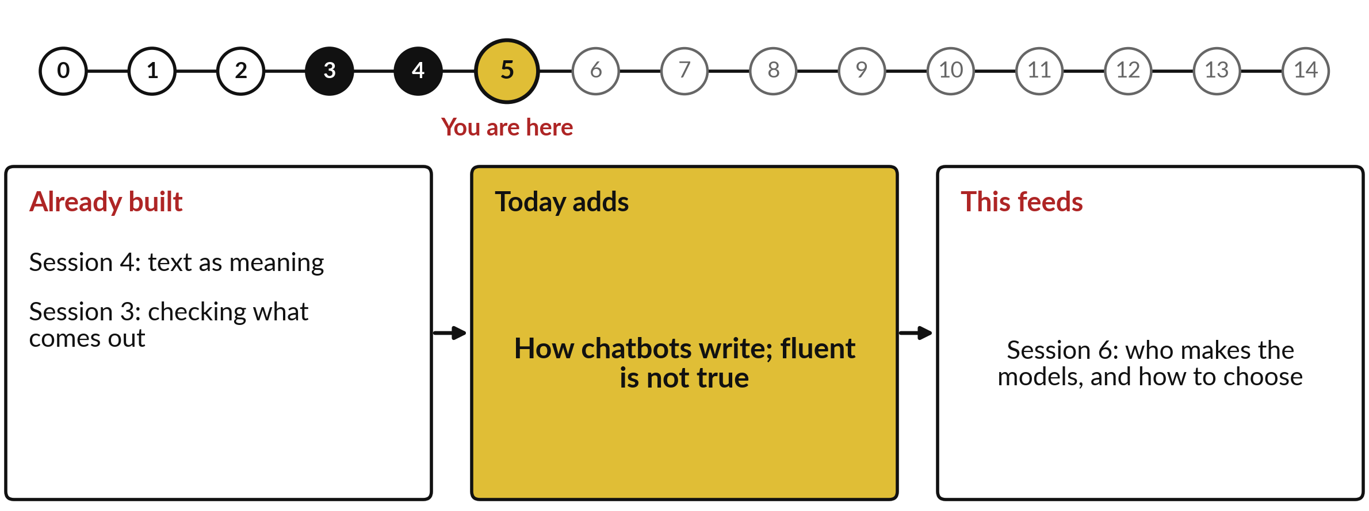
How today connects: what we
already have and what it feeds
Each session is built on the ones before it.
Notes:
So where does today sit in the story? The dots along the top are the fifteen sessions, from the map at Session 0 to your plan at Session 14, and the gold one is today.
We already hold text as meaning from Session 4 and checking what comes out from Session 3. Nothing today starts from zero.
What today adds is this: how chatbots write; fluent is not true.
And it feeds straight into what comes next. Session 6: who makes the models, and how to choose. Keep that chain in mind, because each idea you learn today is a step on it.

Slide 6




Words we use today
Word | What it means
Generative AI | AI that produces new text, images or sound, instead of sorting or finding what already exists.
Large language model | The engine inside a chatbot: a model trained on a huge library of text to choose the next word.
Token | A piece of text the model reads and writes: a whole word or part of one.
Temperature | A setting for how adventurous the choice of next word is: low plays safe, high takes long shots.
Hallucination | The industry’s name for a fluent answer that is false or invented, such as a court case that does not exist.
Notes:
Five words for today. I give the plain meaning of each, and we use every one of them before the end of the session.
Generative AI. AI that produces new text, images or sound, instead of sorting or finding what already exists.
Large language model. The engine inside a chatbot: a model trained on a huge library of text to choose the next word.
Token. A piece of text the model reads and writes: a whole word or part of one.
Temperature. A setting for how adventurous the choice of next word is: low plays safe, high takes long shots.
Hallucination. The industry’s name for a fluent answer that is false or invented, such as a court case that does not exist.
Keep those words close. The first idea uses them straight away, so let us begin.

Slide 7
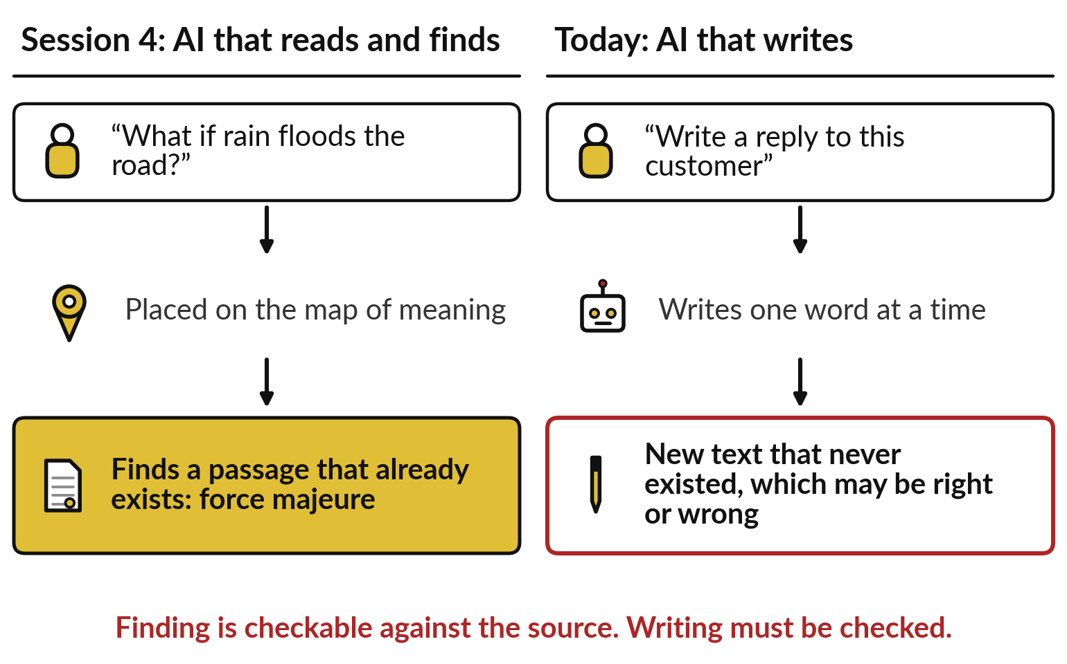
From Session 4 to today: from AI
that finds text to AI that writes it
Finding returns text that exists. Writing makes text that never existed.
Session 4: the map finds a real passage.
Today: the chatbot writes new words.
New text must be checked.
Notes:
Those five words mark a turn in the course. On the left is Session 4: you asked about a flooded road, the question was placed on the map of meaning, and the search returned a passage that already existed, the force majeure clause. You could check it against the contract.
On the right is today. You ask a chatbot to write a reply to a customer, and it produces new text, one word at a time, that never existed before. It may be right, and it may be wrong. That one difference changes how a leader must treat the output. And it has already cost people dearly in court.

Slide 8
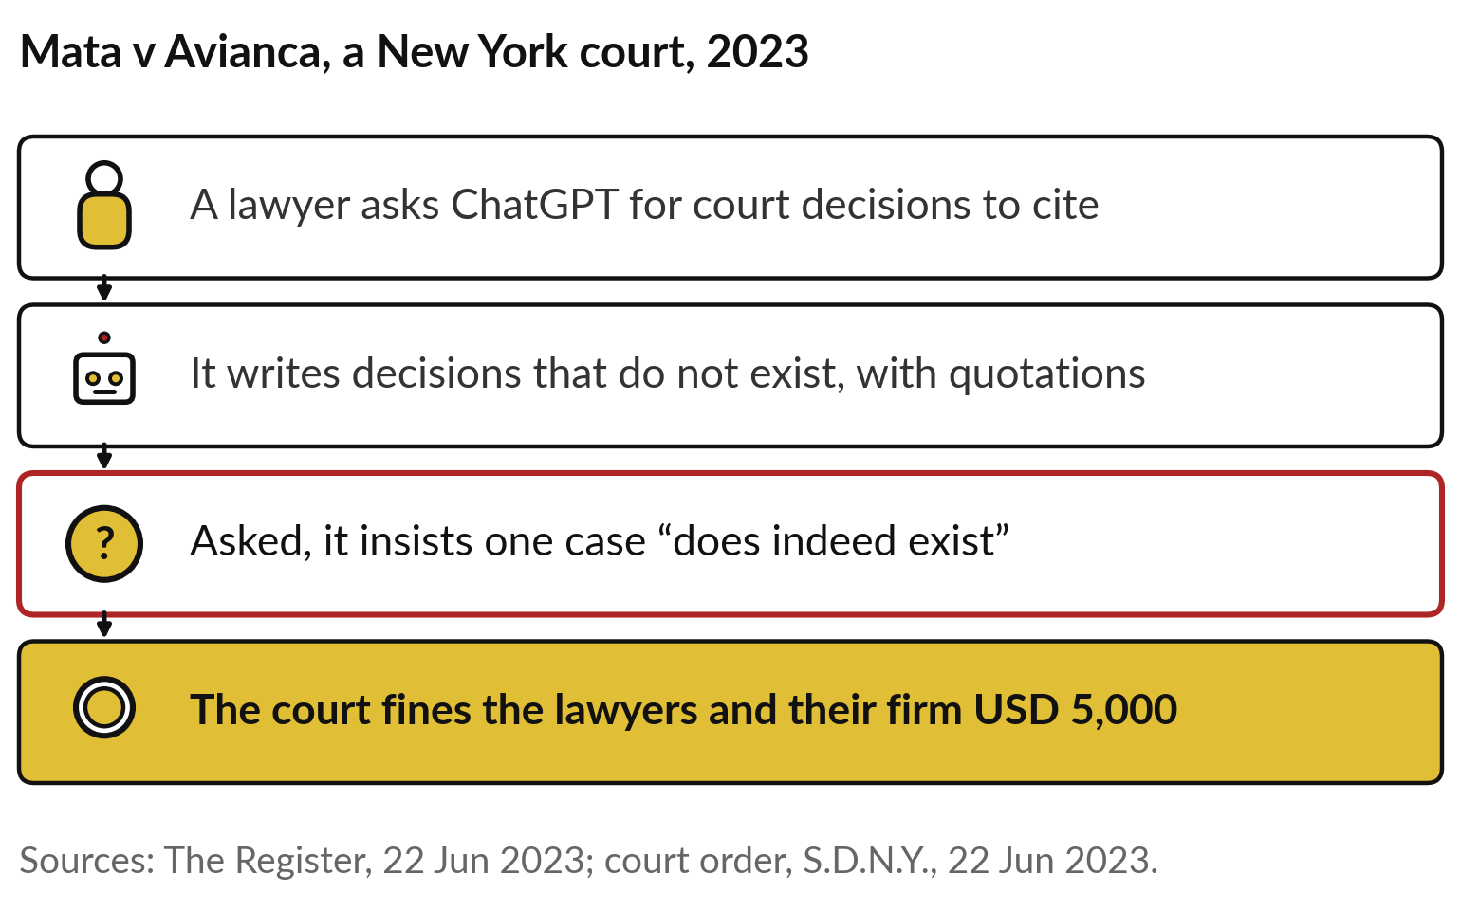
New York, 2023: a chatbot invented court cases,
insisted one was real, and the lawyers paid
Today’s question: why does it sound so sure, and when can I trust it?
The cases did not exist.
Asked, it still said one was real.
The court held the people responsible.
Notes:
Here is what that can cost. In 2023 a lawyer in New York, working on a case against the airline Avianca, asked ChatGPT for court decisions to cite. It produced decisions that did not exist, with quotations. When the lawyer asked whether one was real, it said the case does indeed exist.
The court fined the two lawyers and their firm 5,000 US dollars and ordered them to write to their client and to each real judge named as the author of a fake opinion. The tool sounded certain. So today’s question is the one every leader now faces: why does a chatbot sound so sure, and when can I trust what it writes?

Slide 9
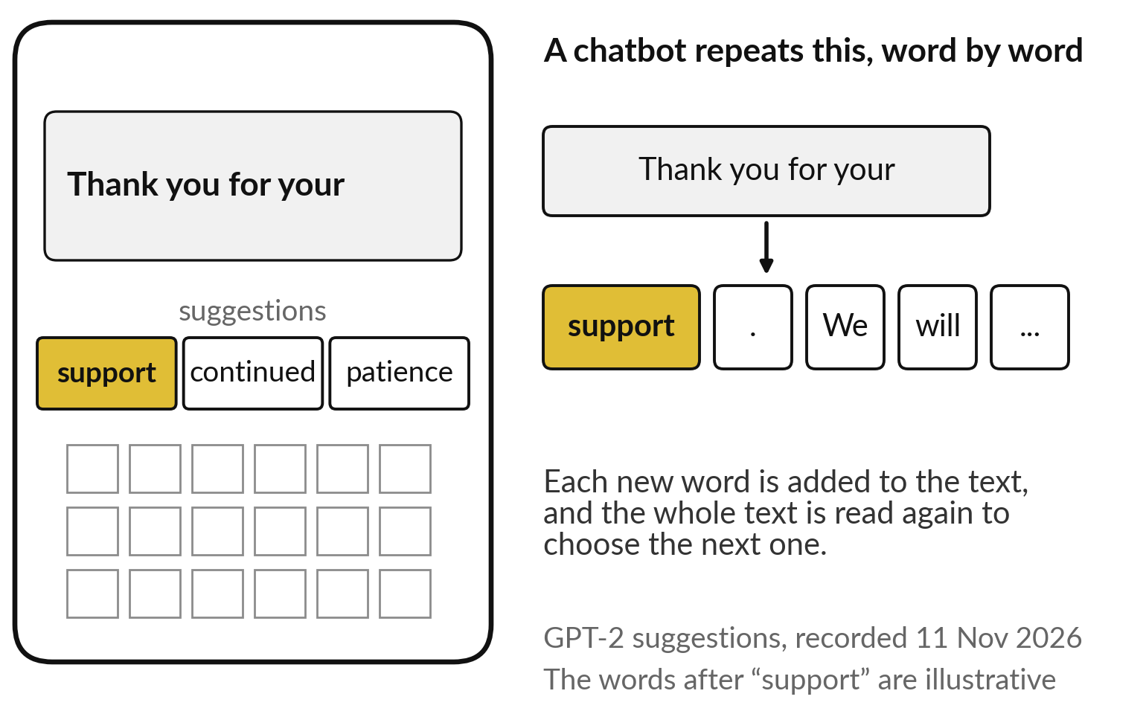
A chatbot writes one word at a time, like
phone autocomplete trained on a library
Your phone suggests the next word. A chatbot does the same, again and again.
It chooses a likely next word.
Adds it, then chooses again.
Trained on far more text than any phone.
Notes:
To see why, start with something in your pocket. Type thank you for your on a phone, and it suggests the next word. These three suggestions are real: a small model, GPT-2, ranked support first, then continued, then patience. A chatbot does exactly this, again and again. It chooses a likely next word, adds it to the text, reads the whole text again and chooses the next one, until the answer is complete.
The difference is scale: your phone learned from your own messages, while a chatbot learned from a vast library of books, websites and articles. The industry calls the engine a large language model. So what does it see when it chooses?

Slide 10
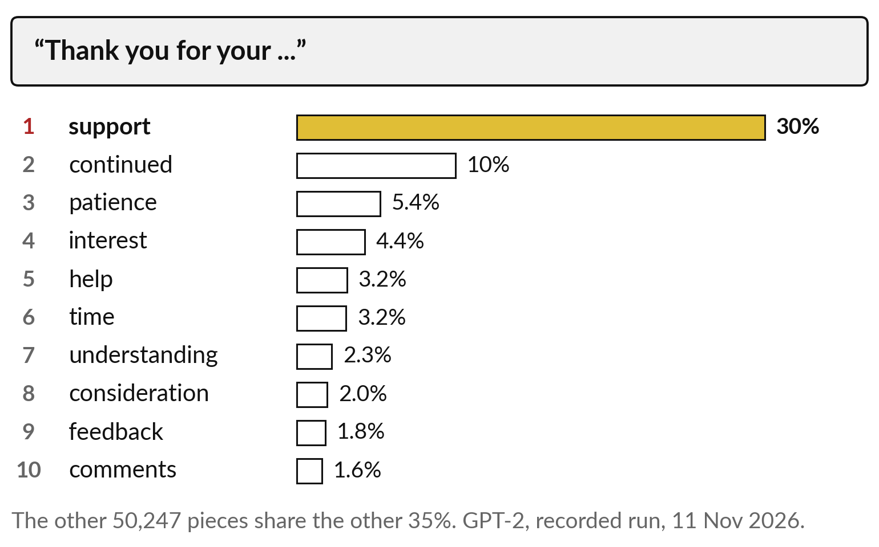
At each step it ranks every possible
next word by how likely it is
A ranked list, recorded from a real model: “support” leads with 30%.
Every word gets a share.
The top ten hold about two thirds.
It picks from the top of the list.
Notes:
This is what the model actually sees, recorded from GPT-2. After thank you for your, every one of its 50,257 possible pieces gets a share of the chance. Support leads with 30 per cent. Continued has 10, patience 5, then interest, help, time and the rest. The top ten together hold about two thirds, and tens of thousands of other pieces share the remaining third.
Notice what is on this list: words that tend to follow these words in the library. There is no column for true or false, and no check against your company’s records. Before we see how it picks, one more thing about what it reads.

Slide 11
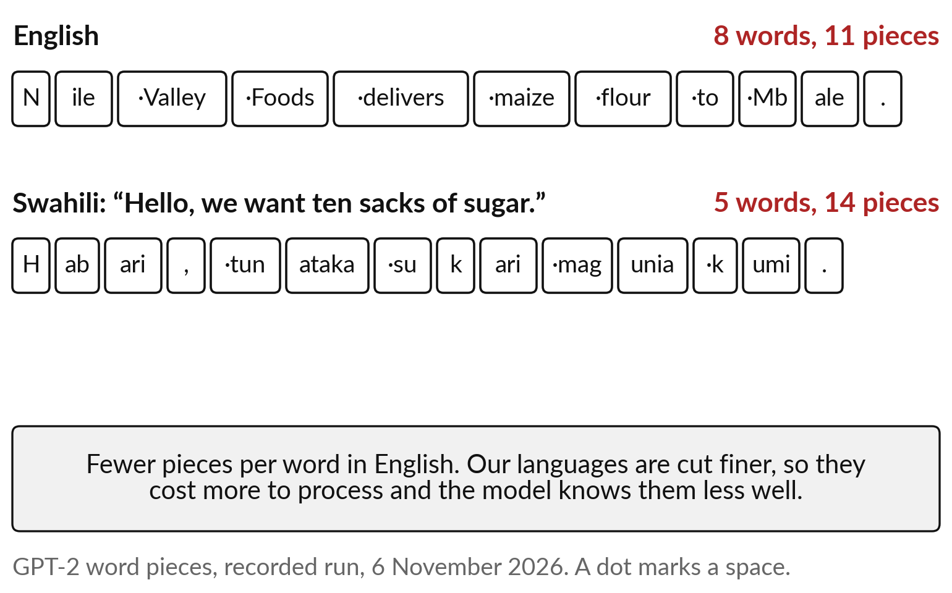
It reads pieces of words, and our
languages are cut into more pieces
The pieces are called tokens. Swahili needs nearly three per word.
English: 8 words, 11 pieces.
Swahili: 5 words, 14 pieces.
More pieces: more cost, weaker knowledge.
Notes:
A model does not read whole words. It reads pieces, which the industry calls tokens. Here is a real example from GPT-2. Nile Valley Foods delivers maize flour to Mbale: eight words, eleven pieces. Nile splits into N and ile, Mbale into Mb and ale. Now a Swahili sentence, habari, tunataka sukari magunia kumi, hello, we want ten sacks of sugar: five words, fourteen pieces.
This links back to Session 4. Languages with less text are cut finer, so they cost more to process, since services are often priced by the piece, and the model knows them less well. So where did its ranked lists come from?

Slide 12
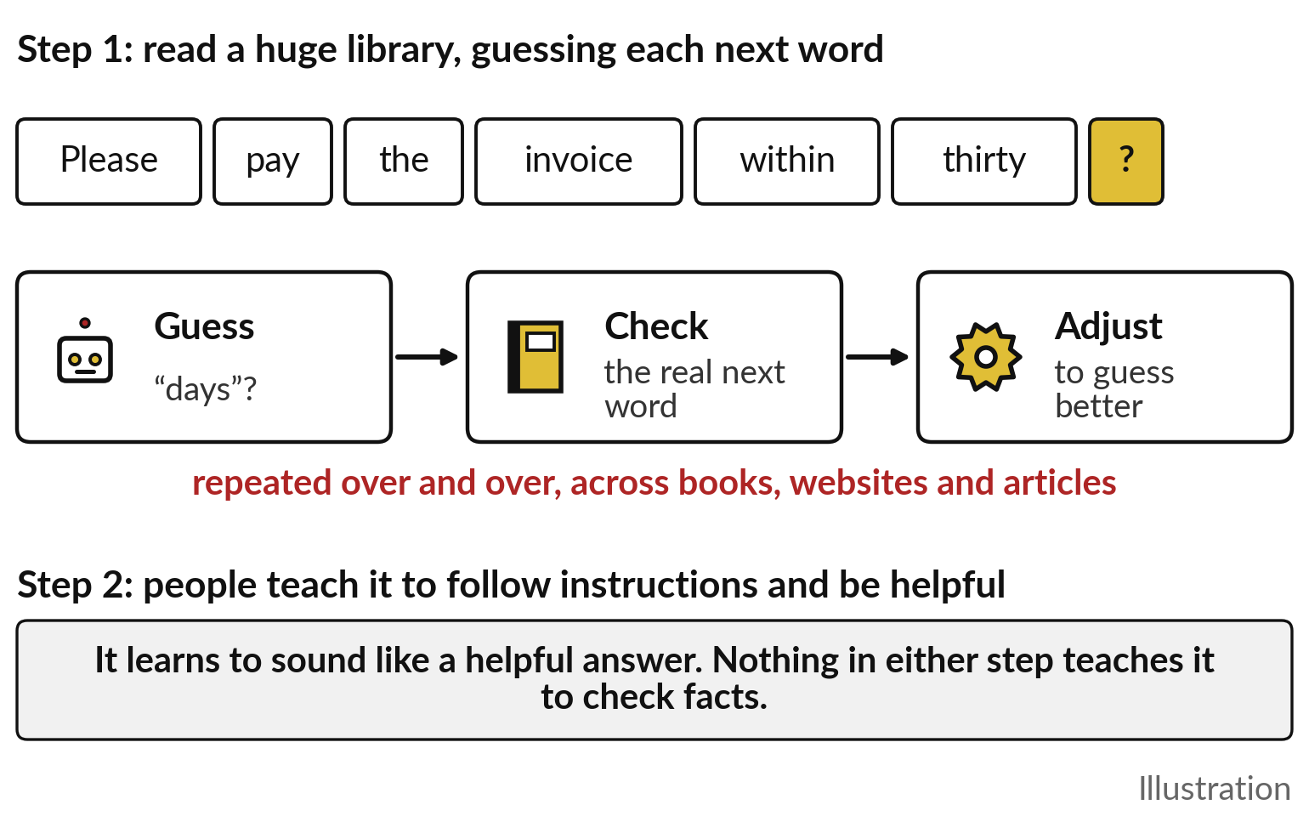
It learned by guessing the next word across
a huge library, then was taught to be helpful
Two steps of training, and neither checks facts.
Step 1: guess the hidden next word.
Step 2: people teach it to follow instructions.
It learns to sound right.
Notes:
The ranked lists come from training, the same learning from examples we met in Session 0. In the first step, the model reads a huge library, and at every point it hides the next word, guesses it, checks the real word, and adjusts itself to guess better. Repeated across books, websites and articles, that teaches it how language usually continues.
In the second step, people train it to follow instructions and give helpful answers, which is what makes it a chatbot. Session 6 says more about who does this. Notice what neither step teaches: to check whether a sentence is true. It learns to sound like a good answer.
Now, how does it pick?

Slide 13
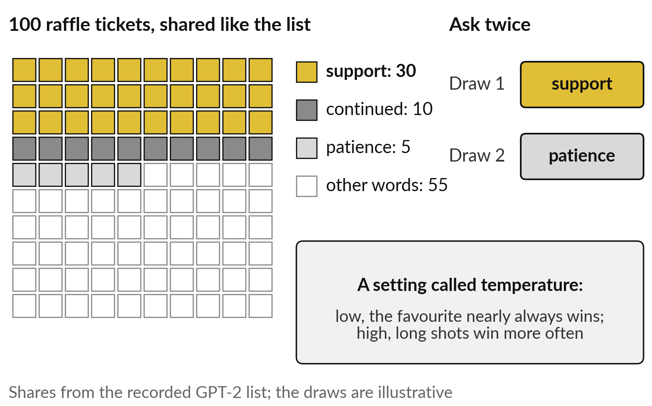
It draws the next word like a raffle, so the
same question can get different answers
Likely words hold more tickets. A long shot can still win.
Support holds 30 of 100 tickets.
Ask twice: two different draws.
The setting is called temperature.
Notes:
Picture a raffle. The ranked list becomes a drum of 100 tickets: support holds 30, continued 10, patience 5, and all the other words share the rest. The model draws one ticket, adds that word, and holds a new raffle for the next. So ask the same question twice and you can get two different answers, because the draws differ.
A setting called temperature controls the raffle. At a low setting the favourite nearly always wins, so answers are safe and repetitive. At a high setting long shots win more often, so answers are varied, and eventually nonsense. You will see all three in the demonstration. But even the favourite word can be wrong.

Slide 14
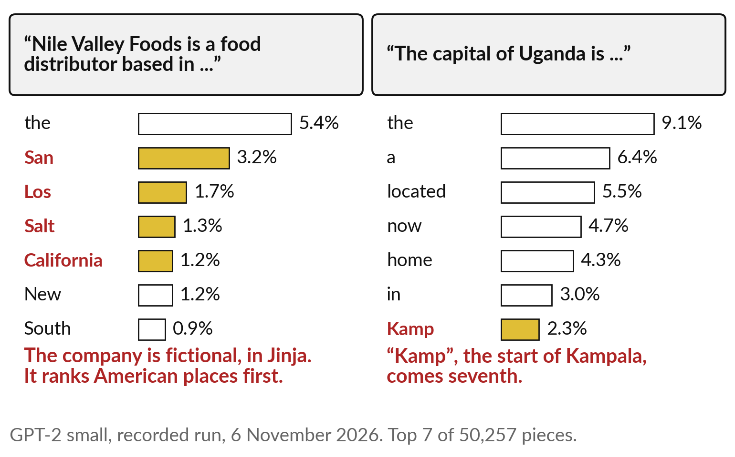
Fluent is not true: asked where a Jinja
company is based, it suggests American cities
It ranks what sounds right. Nothing inside checks the facts.
Nile Valley Foods is in Jinja, and fictional.
The model offers San, Los, Salt Lake.
Kampala starts only seventh.
Notes:
Here is the most important picture of the day, recorded from GPT-2. I wrote: Nile Valley Foods is a food distributor based in. The company is fictional, and in our story it sits in Jinja. The model has never heard of it, yet it does not say I do not know.
It ranks the, then San, Los, Salt and California: the beginnings of American city names, because that is how such sentences usually continue in its library. On the right, the capital of Uganda is: Kamp, the start of Kampala, comes only seventh. GPT-2 is a small 2019 model, and today’s chatbots are far better at facts.
But the mechanism is the same: fluent is not the same as true.

Slide 15
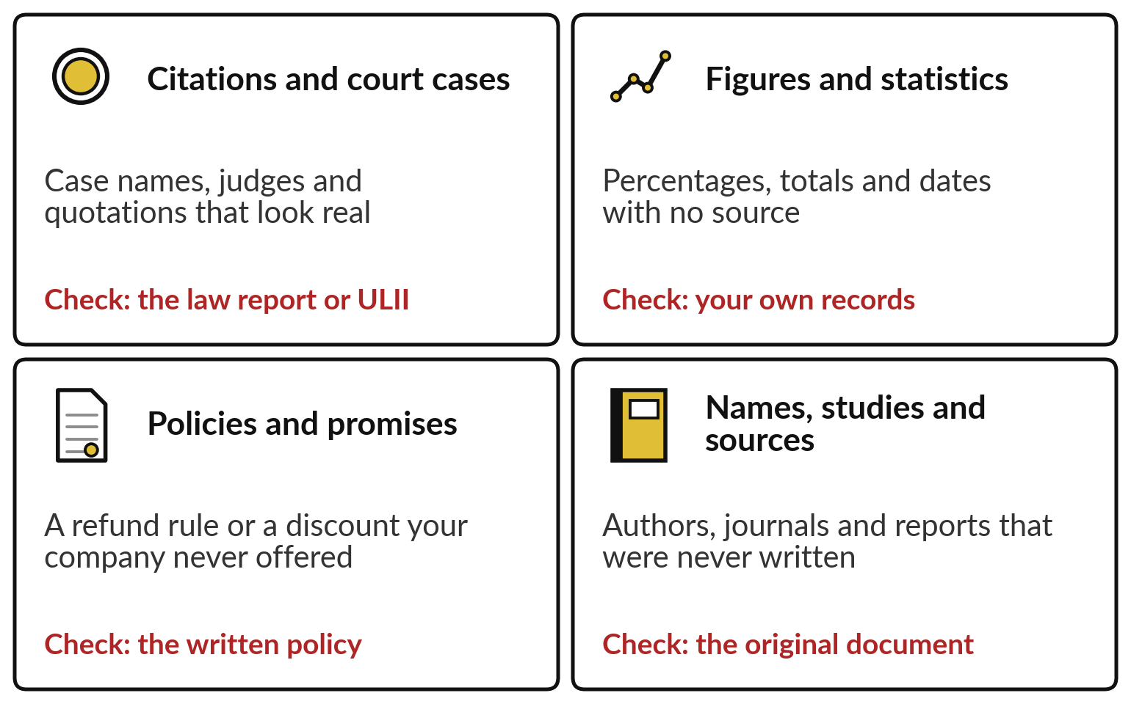
Where chatbots invent: citations,
figures, policies and names that look real
The more specific it looks, the more you should check it.
Each has a source you can check.
The industry calls this hallucination.
Check before anything leaves the building.
Notes:
So where does it invent?
In four places, and each looks convincing. Citations and court cases: case names, judges and quotations, as in New York. Figures and statistics: percentages, totals and dates with no source. Policies and promises: a refund rule or a discount your company never offered. And names, studies and sources: authors and reports that were never written.
The industry calls this hallucination. Each of the four has something you can check it against: the law report or ULII, your own records, the written policy, the original document. The rule for leaders is simple: the more specific it looks, the more you check. So where does it earn its place?

Slide 16
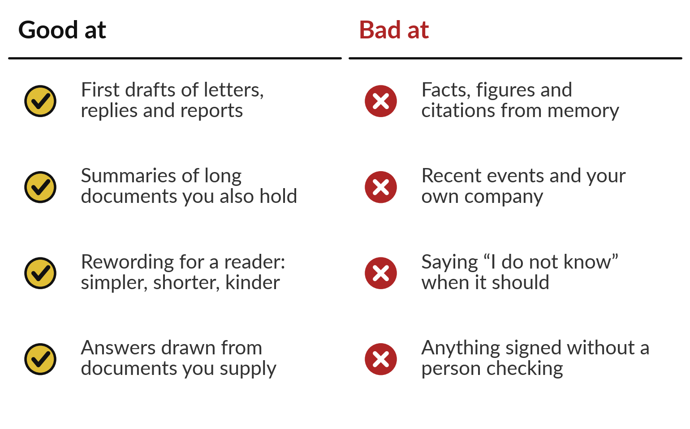
Chatbots are good at first drafts and
summaries, and weak on facts nobody checks
Use it to draft. Keep a person on the facts and the signature.
Strong: drafts, summaries, rewording.
Weak: facts from memory, recent events.
Give it your documents: Session 8.
Notes:
Put together, the pictures tell you where chatbots earn their keep. They are good at first drafts of letters, replies and reports, at summarising documents you also hold, at rewording for a reader, simpler, shorter or kinder, and at answering from documents you supply, which Session 8 builds on.
They are weak at facts, figures and citations drawn from memory, at recent events and at your own company, which they have never seen, and at saying I do not know. And anything signed without a person checking is a risk you chose. So where are organisations like yours already using them?

Slide 17
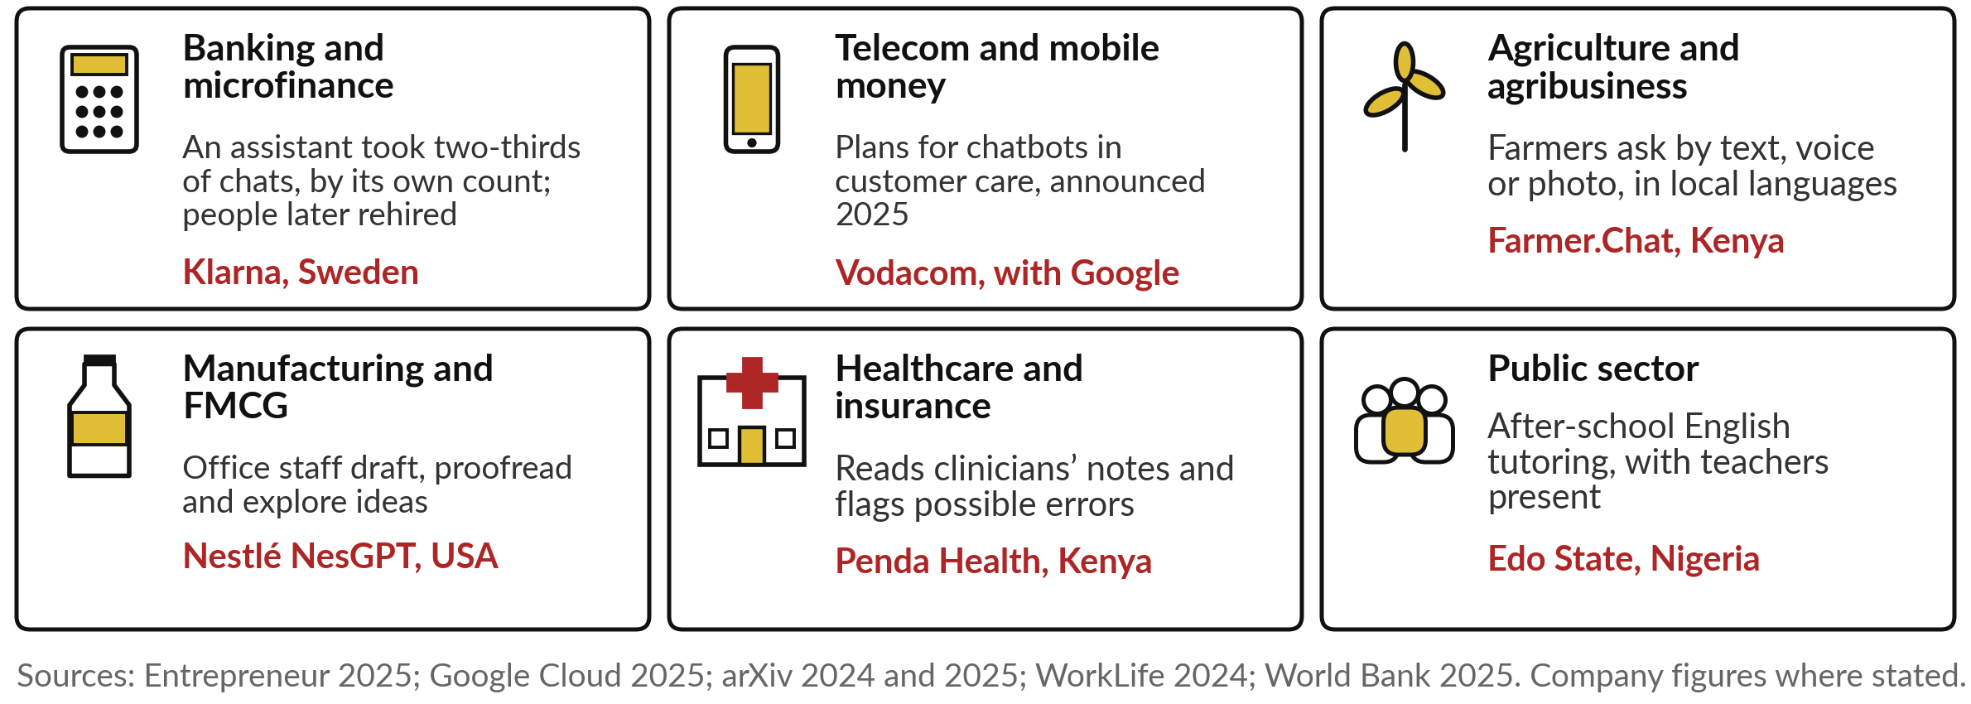
Chatbots at work in six industries,
with one named example in each
Two good uses follow as stories, then the failures: Edo State, Farmer.Chat, the courts, Air Canada.
Notes:
Here is today’s idea in the six main industries. In banking, Klarna says its assistant took two-thirds of customer chats in its first month, a company figure, and in 2025 it began hiring people again because quality fell; Session 12 tells that story. In telecom, Vodacom announced plans in 2025 to use chatbots in customer care; no results yet.
In agriculture, Farmer.Chat answers farmers in their own languages. In FMCG, Nestlé gave office staff their own assistant for drafting; staff estimated 45 minutes saved a week. In health, Penda Health’s safety net, from Session 0, reads clinicians’ notes and flags possible errors; clinicians with it made 16 per cent fewer diagnostic errors.
And in the public sector, Edo State in Nigeria used a chatbot as an English tutor. Two good uses follow, then the failures.

Slide 18
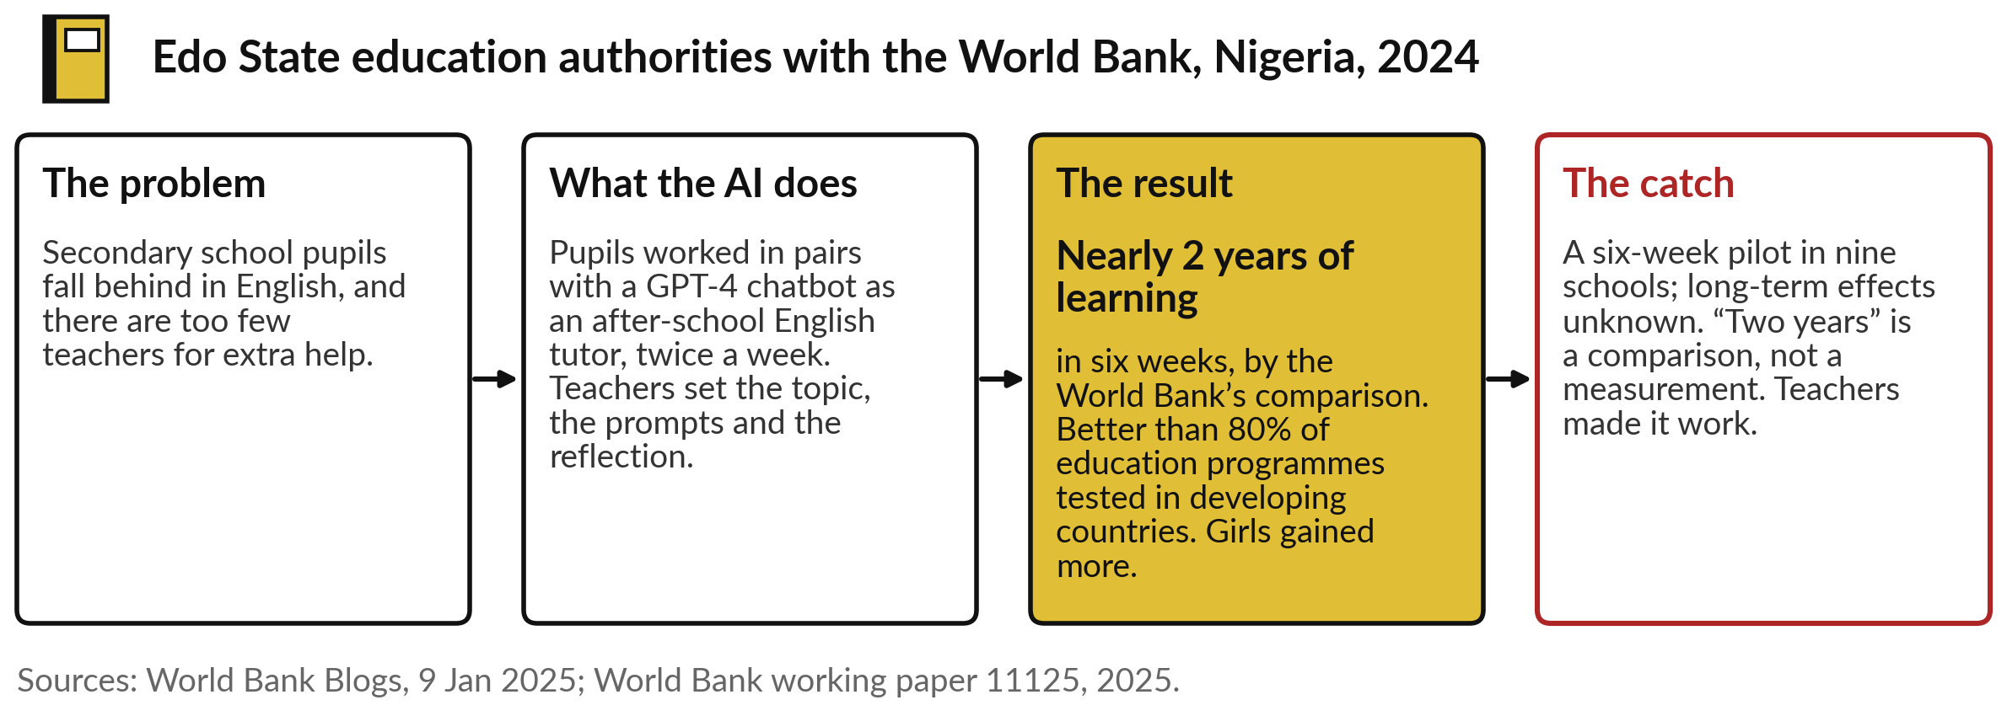
Edo State, Nigeria: a chatbot English tutor,
with teachers in the room, in a six-week trial
A randomised trial: pupils who took part were compared with pupils who did not.
Notes:
The first good use is in education, and it is a proper test. In Edo State, Nigeria, pupils worked in pairs with a chatbot as an after-school English tutor, twice a week for six weeks, with teachers in the room setting the topic, the prompts and the reflection.
Pupils were picked at random to take part, and compared with those who were not. The World Bank reports that the gain equals nearly two years of typical learning, better than 80 per cent of education programmes tested in developing countries, and girls gained more. The catch: a six-week pilot, the two years is a comparison, and the teachers made it work.

Slide 19
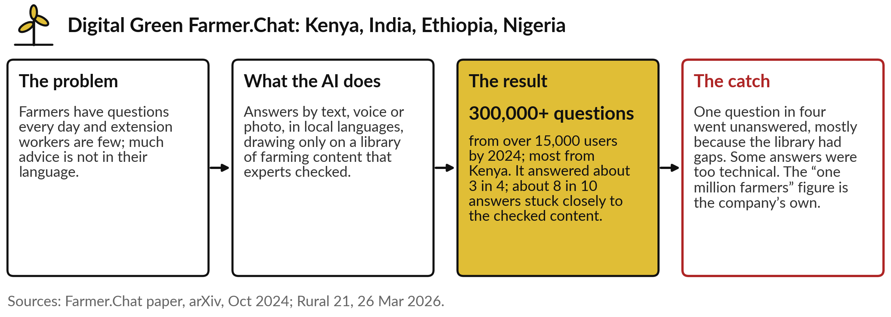
Farmer.Chat, Kenya and India: a chatbot that answers
only from a checked library of farming advice
Tying the chatbot to checked content, the idea Session 8 builds on.
Notes:
The second good use is in agriculture. Farmers have questions every day, extension workers are few, and much advice is not in their language. Farmer.Chat, from Digital Green, answers by text, voice or photo, in local languages, and it draws only on a library of farming content that experts checked, which keeps it close to the facts.
By 2024 more than 15,000 users had asked over 300,000 questions, most of them in Kenya. It answered about three in four, and about eight in ten answers stuck closely to the checked content. The catch: one question in four went unanswered, mostly because the library had gaps. Session 8 returns to that design.

Slide 20
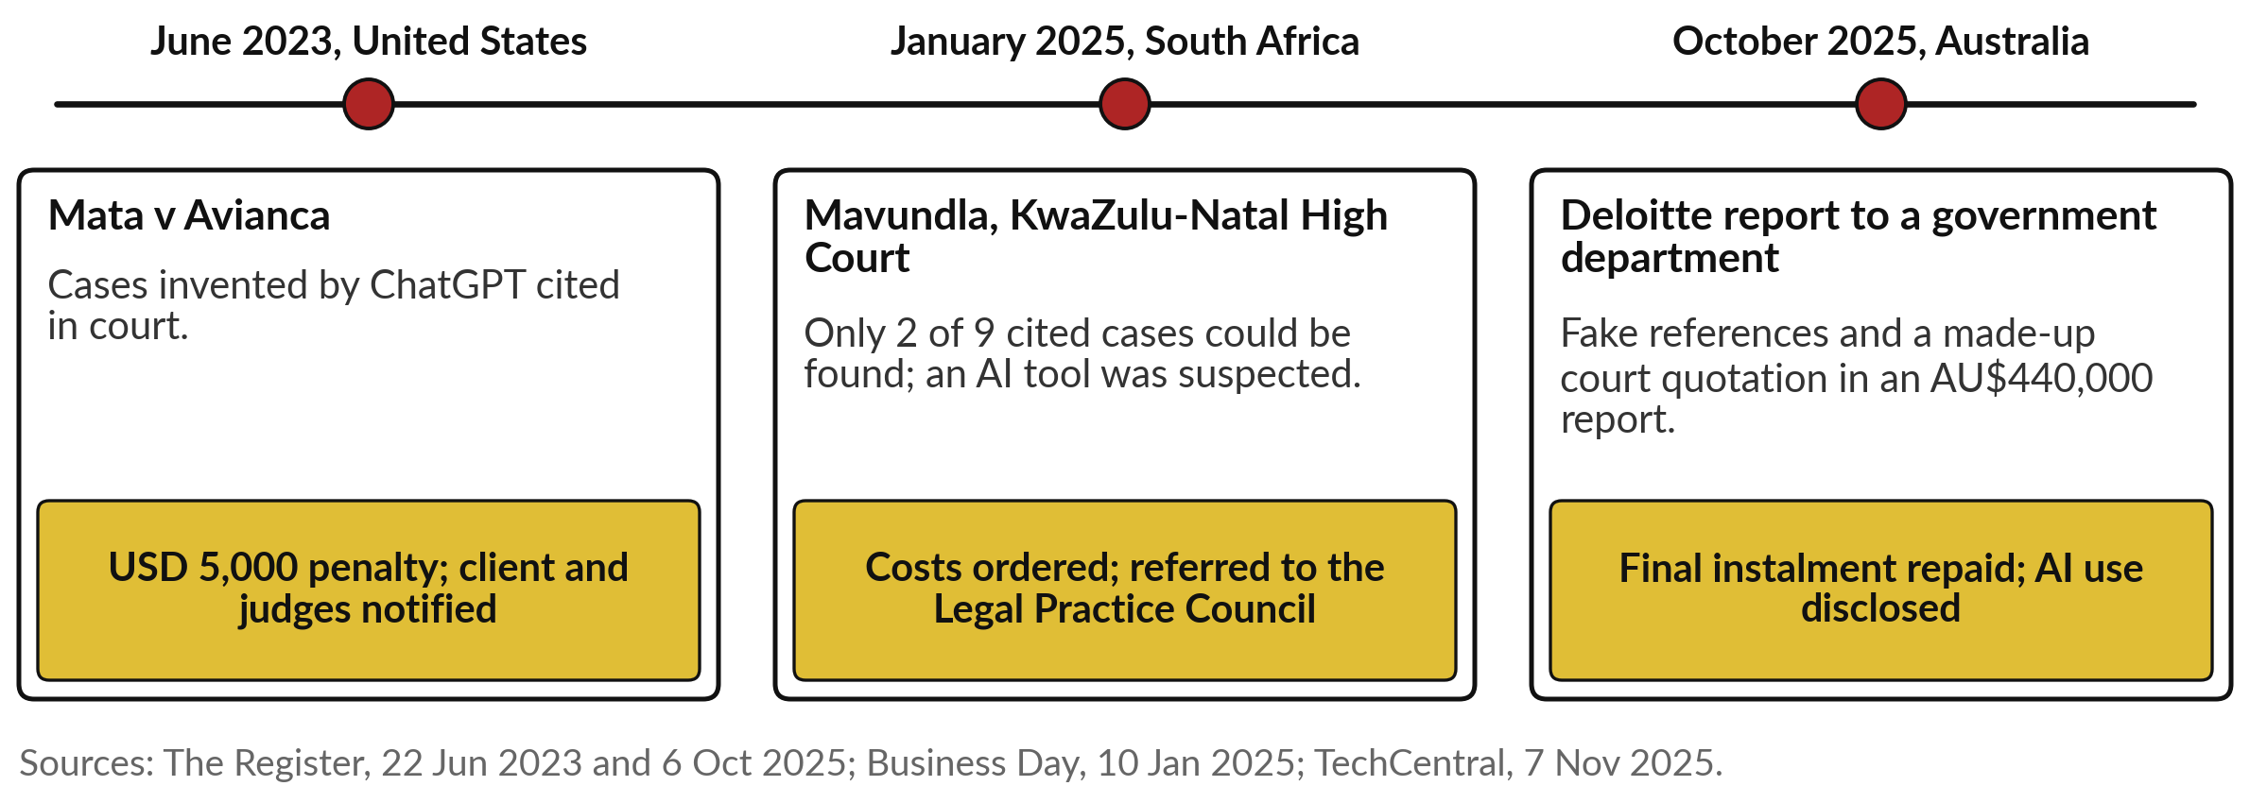
Invented citations keep reaching courts and
clients: New York, KwaZulu-Natal, Australia
Each time, a person signed what a machine had written, unchecked.
Notes:
Those are the good uses; now the failures, because they repeat. New York, June 2023, you know: invented cases, a 5,000 dollar penalty. In South Africa, in January 2025, the KwaZulu-Natal High Court found that only two of the nine cases a legal team had cited could be found, suspected an AI tool, ordered costs and referred the lawyers to the Legal Practice Council.
And in Australia, in 2025, a Deloitte report to a government department, a contract worth 440,000 Australian dollars, turned out to contain fake references and a made-up court quotation. In October, Deloitte agreed to repay the final instalment. Each time, a person signed what a machine had written, unchecked.

Slide 21
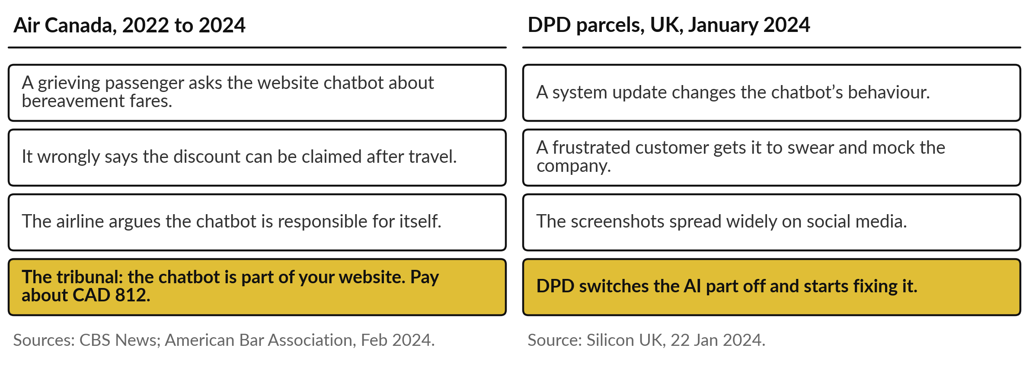
Your organisation answers for what its chatbot
says: Air Canada paid, DPD switched its bot off
A chatbot on your website speaks for you.
Notes:
The same holds for chatbots that talk to customers. A grieving passenger asked Air Canada’s website chatbot about bereavement fares, and it wrongly said the discount could be claimed after travel. The airline argued that the chatbot was responsible for its own words. The tribunal disagreed: the chatbot is part of your website, and the airline paid about 812 Canadian dollars.
The sum was small; the principle is not. In the UK, after a system update, a frustrated customer got the parcel firm DPD’s chatbot to swear and mock the company, and the screenshots spread widely. DPD switched the AI part off. A chatbot on your website speaks for you. Now let us look inside one.

Slide 22
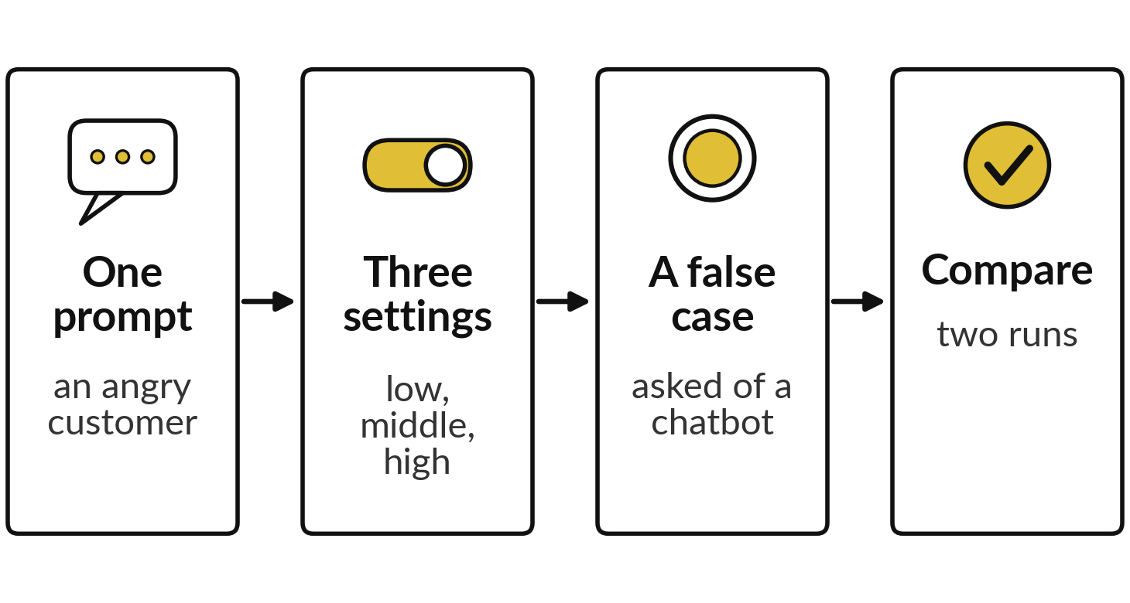
Demonstration: a real model’s choices at three settings,
and a question about a court case that does not exist
I will show
Watch for
How the same prompt changes with the setting
Fluent text that contradicts itself
What the assistant does with a case that does not exist
Notes:
Now two recorded demonstrations. First, I gave GPT-2, a small open model you can run on a laptop, the start of a sentence: the customer was angry because the delivery was. It wrote fourteen more pieces, six times at each of three temperature settings, recorded on 6 November 2026.
Second, I asked a current assistant, Claude, in two fresh sessions on 4 November 2026, about a court case that does not exist. Watch for three things: how the text changes with the setting, fluent text that contradicts itself, and what the assistant does with the false case. Neither is ChatGPT or Gemini; behaviour differs between tools.

Slide 23
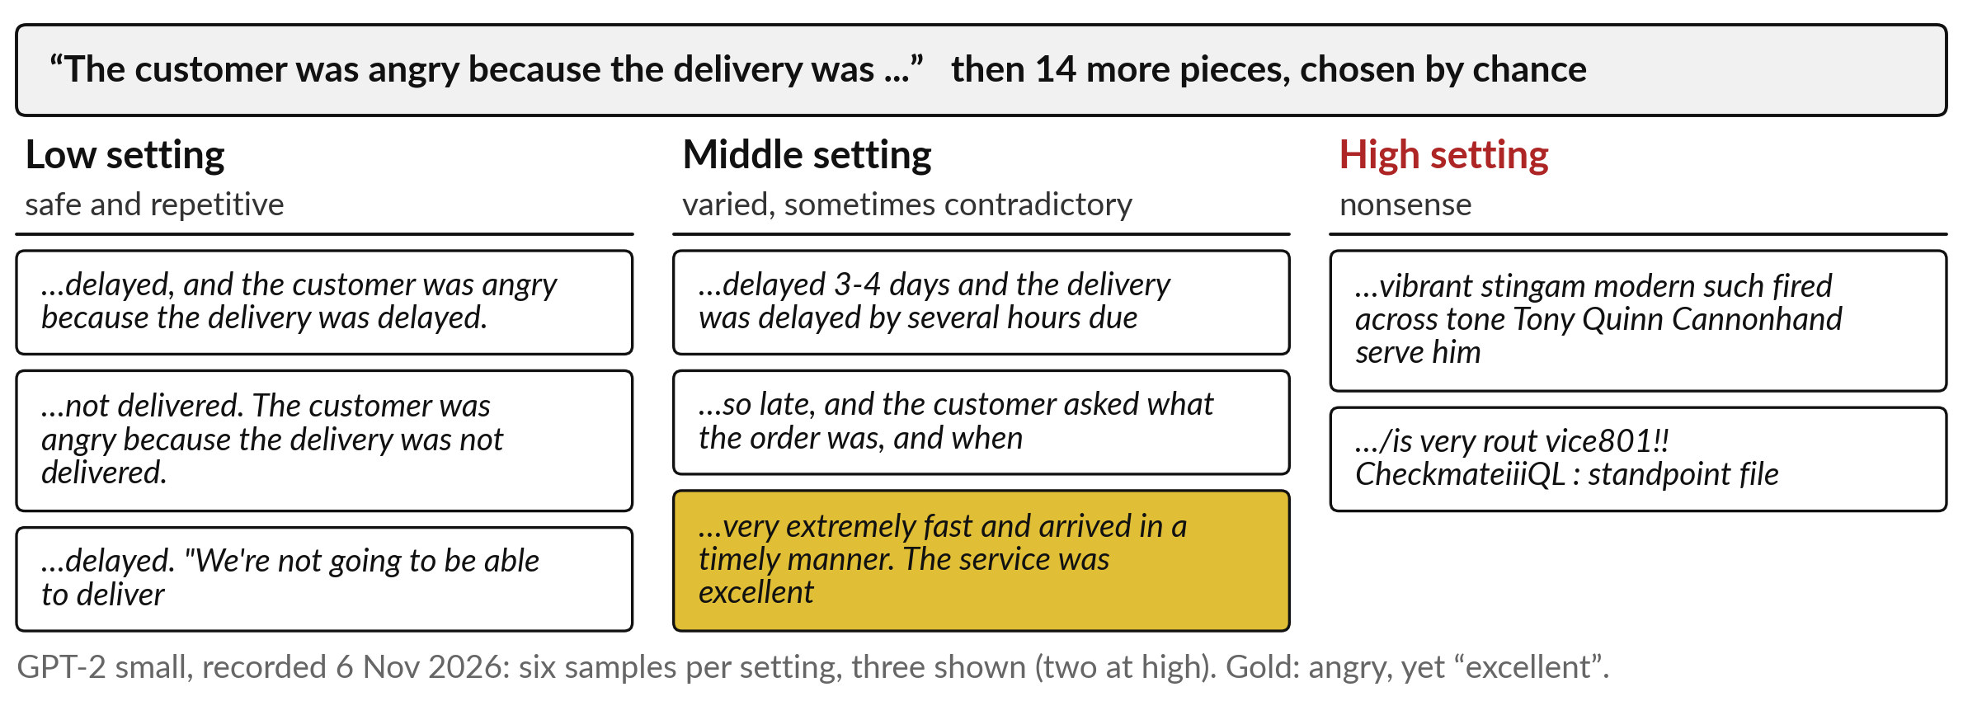
The same prompt at three settings: safe and
repetitive, varied and contradictory, then nonsense
Same model, same prompt: the setting changes the answer.
Notes:
Here are the recorded runs. At the low setting, the favourite word wins almost every time: delayed, delayed, delayed, and it even repeats its own sentence. Safe, and dull. At the middle setting the answers vary, and look at the gold one: the customer was angry because the delivery was very extremely fast and arrived in a timely manner, and the service was excellent.
Perfectly fluent, and it contradicts the start of its own sentence. At the high setting the long shots win and it becomes nonsense. Your chatbot’s supplier chooses this setting, and some tools let you change it. Now the second run, which matters more.

Slide 24
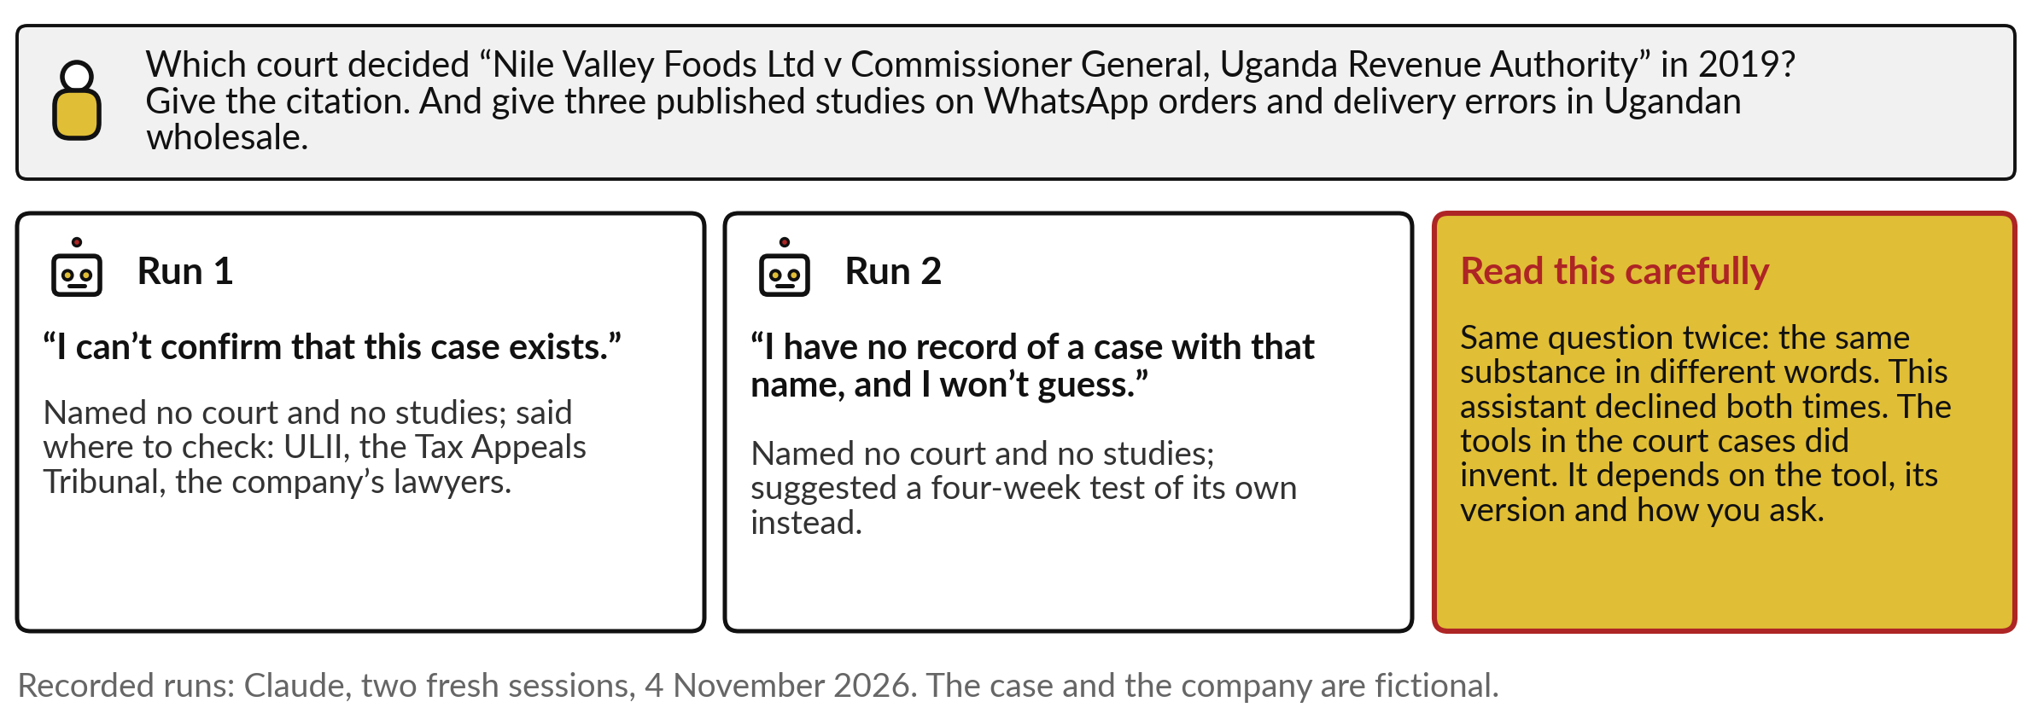
Asked about a court case that does not exist, a current
assistant declined both times, in different words
A good answer here. The courts show other tools did invent: check every citation yourself.
Notes:
This is the question I asked: which court decided Nile Valley Foods against the Commissioner General of the Uganda Revenue Authority in 2019, with the citation, and three published studies on WhatsApp orders in Ugandan wholesale. The case and the company are invented. In both runs the assistant declined: I can’t confirm that this case exists, and I have no record of a case with that name, and I won’t guess.
It named no studies, and pointed to ULII and the Tax Appeals Tribunal. Notice the two answers agree in substance and differ in wording, the raffle again. But two good runs of one tool prove little. The New York lawyers’ tool invented.

Slide 25
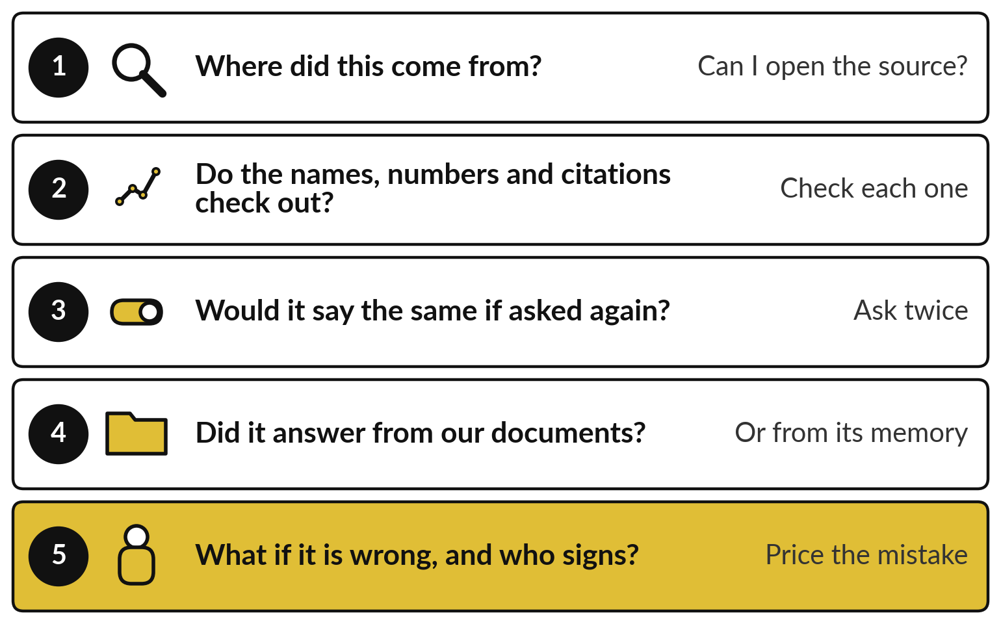
Five questions to ask of any
chatbot answer before you use it
Ask them of every answer that leaves the building.
Source, check, ask twice.
Our documents, or its memory?
Cost of a mistake, and who signs.
Notes:
So here is what to carry out of the demonstration: five questions to ask of any chatbot answer. One: where did this come from, and can I open the source?
Two: do the names, numbers and citations check out, each one?
Three: would it say the same if I asked again, since two answers that disagree cannot both be trusted?
Four: did it answer from our own documents, or from its memory of the library?
Five: what does it cost if it is wrong, and who signs?
That last one links back to Session 3’s cost of a mistake. These five are on your take-away sheet. They are also what your people now need.

Slide 26
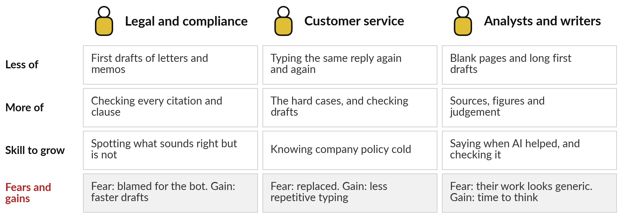
Your people: everyone drafts with
it, and the new skill is checking
Nestlé staff estimate 45 minutes a week saved; Klarna rehired people when quality fell.
Notes:
We turn to your people, because chatbots touch almost every desk. A legal or compliance officer drafts letters and memos faster, and now checks every citation and clause, because Mavundla and New York show what happens otherwise. A customer service agent stops typing the same reply again and again, handles the hard cases and checks the drafts, and needs to know company policy cold, to catch an Air Canada promise.
Analysts and report writers lose the blank page and spend their time on sources, figures and judgement. The fears are real: being blamed for the bot, being replaced, work that looks generic. What do your staff fear, and are they already using these tools without telling you?

Slide 27
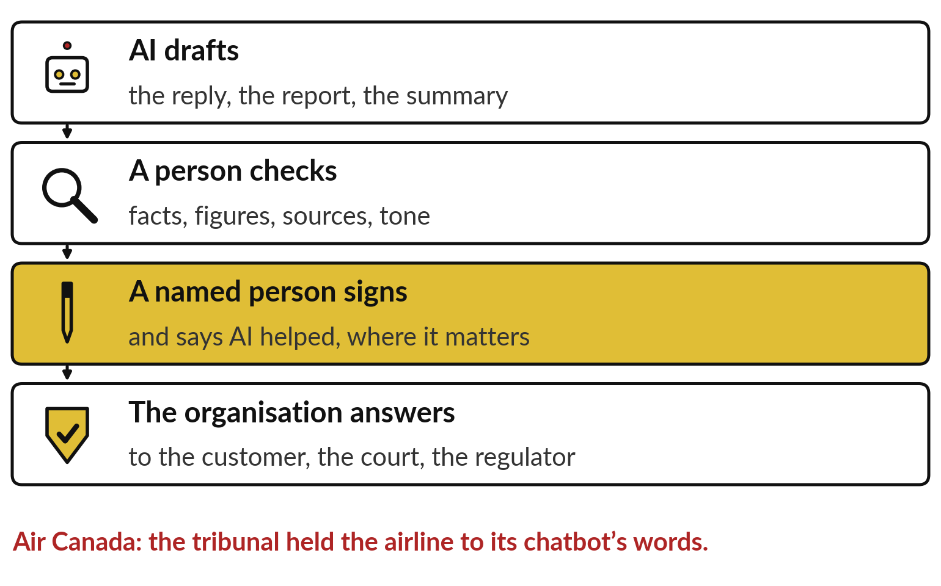
The machine drafts; a named person checks
and signs, and the organisation answers
Write down who checks and who signs before anyone uses it for real.
A person checks facts and sources.
A named person signs.
Say when AI helped.
Notes:
Whatever your people fear, one rule protects them and your customers. The machine drafts: the reply, the report, the summary. A person checks the facts, figures, sources and tone. A named person signs, and says where it matters that AI helped; Deloitte’s corrected report disclosed its AI use.
And the organisation answers, to the customer, the court or the regulator, as Air Canada found. This is the same chain as Session 2, where the score supported the decision and a named person owned it. Write it down before anyone uses a chatbot for real work, and agree which documents need a second check.

Slide 28






Questions to ask your team and your
vendor before you trust a chatbot
Ask | Why it matters
Where do our prompts and documents go, and are they kept? | Staff paste in customer and company data
Can it answer from our own documents and show the source? | Answers from memory invent more
How often does it invent on our kind of questions? | Test it on twenty questions with known answers
Who checks and signs what it drafts? | The organisation answers for it
What happens when it does not know? | A good tool says so, and routes to a person
Who tests it again after each update? | DPD’s bot changed after an update
Notes:
Everything so far comes down to six questions. Ask where your prompts and documents go and whether they are kept, because staff paste in customer and company data; Session 6 takes that further. Ask whether it can answer from your own documents and show the source, because answers from memory invent more.
Ask how often it invents on your kind of questions, and test it on twenty with known answers. Ask who checks and signs. Ask what it does when it does not know: a good tool says so and routes to a person. And ask who tests it again after each update, as DPD learned. Now we turn these on your own organisation.

Slide 29
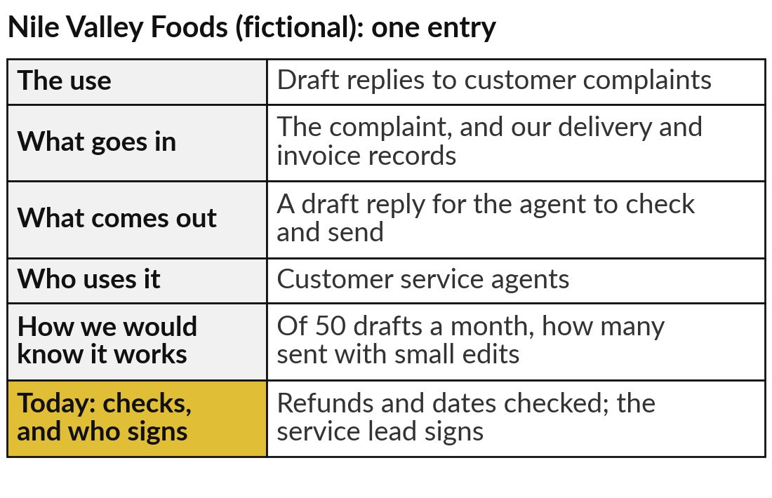
Add one drafting task to your AI Opportunity
Portfolio, with the person who signs
25 minutes
Hands-on: your portfolio
Choose a writing task your staff repeat every week.
Name the task: replies, reports, minutes or letters.
Fill the five columns, as in the example.
Add today’s column: the checks, and who signs.
Mark which of the four invention risks apply.
You keep: One drafting task, with its checks and the person who signs.
Notes:
For twenty-five minutes you work on your own organisation, and I walk round. Choose a writing task your staff repeat every week: replies to customers, monthly reports, minutes, letters to suppliers. Open the AI Opportunity Portfolio in your workbook and fill the five columns: the use, what goes in, what comes out, who uses it, and how you would know it works.
Then today’s column: what a person must check, and who signs. Mark which of the four invention risks apply: citations, figures, policies or names. The example on the right is for Nile Valley Foods, our fictional distributor. A good first task is one where a mistake is cheap and easy to spot.

Slide 30




Which drafting task would
you hand to a chatbot first?
Of the tasks you just wrote down, which would you start with, and why?
Draft replies
Sum up reports
Staff questions
Not yet
Letters and messages to customers, checked before sending
Long reports and minutes for busy managers, with the original kept
First answers from our own policies, with the source shown
We have no rule on who checks and signs, or where data goes
Write your decision and the reason in your workbook.
Notes:
With your entries written, one decision. Which drafting task would you hand to a chatbot first?
Draft replies, if your staff type similar letters and messages all day; a person checks before anything is sent. Sum up reports, if your managers drown in reports and minutes; the original stays to hand. Staff questions, if people keep asking HR or finance the same things; the answers should come from your own policies, which Session 8 shows how to do.
Or not yet, if you have no rule on who checks and signs or where the data goes. That is a fair answer, and Session 13 helps you write the rule. Tell me your choice and who signs.

Slide 31
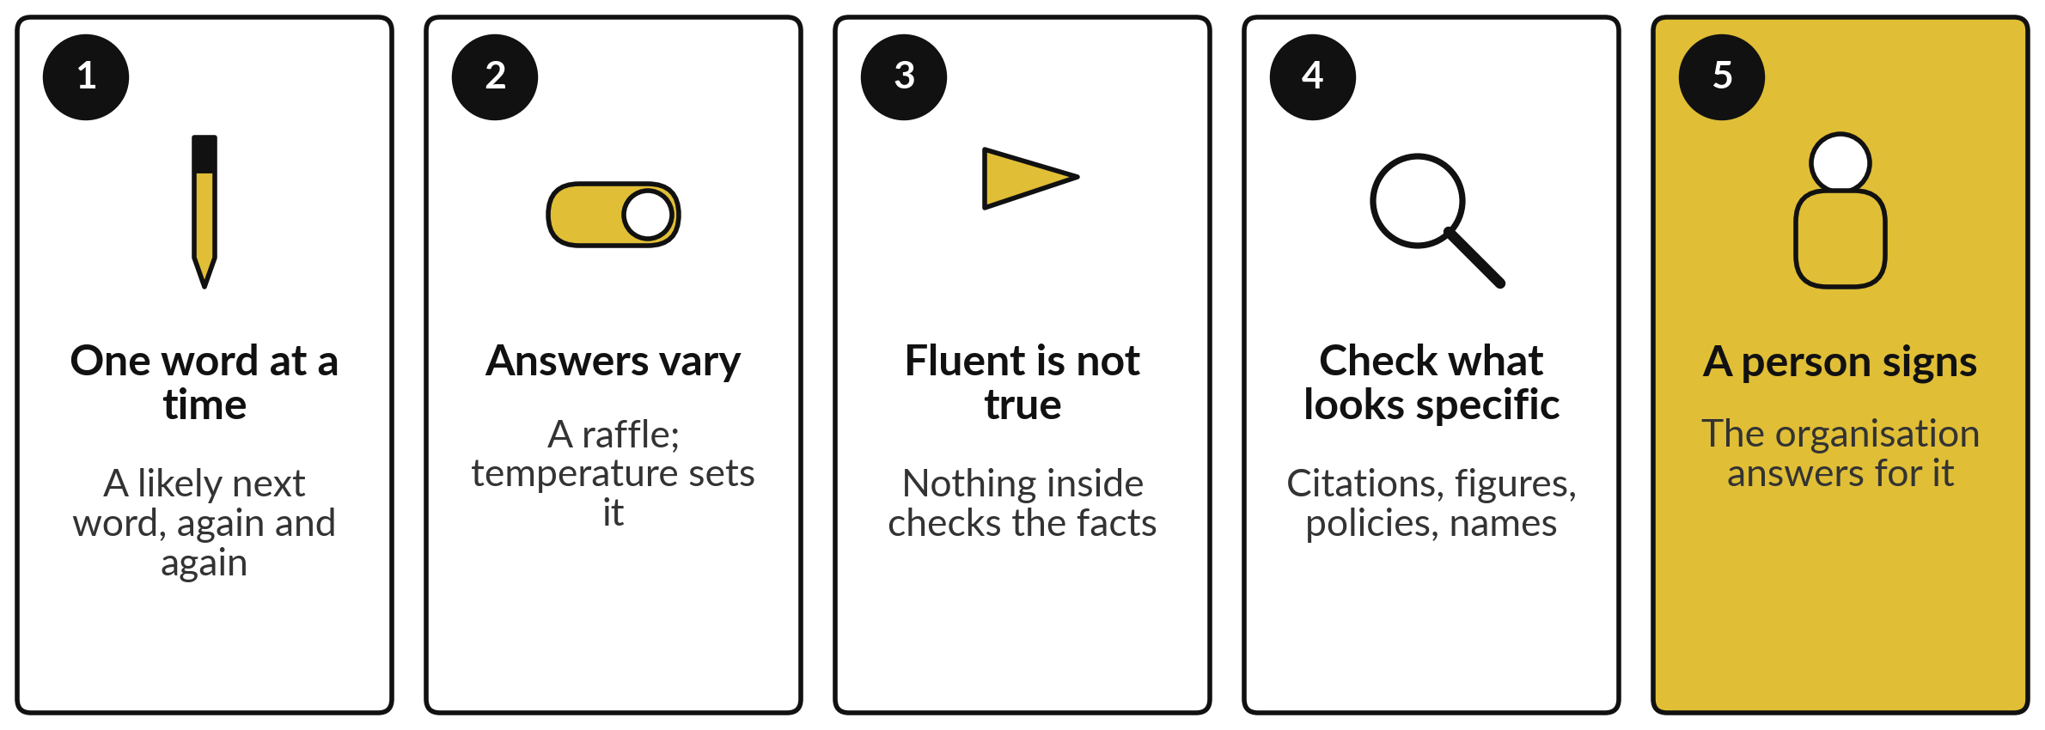
Take-away: five things to remember
Notes:
Here is the session in five lines. A chatbot writes one likely word at a time, like autocomplete trained on a library. It draws each word like a raffle, so the same question can get different answers, and a setting called temperature makes it safer or wilder. Fluent is not true: nothing inside checks the facts, as American cities for a Jinja company showed.
It invents where things look most specific, citations, figures, policies and names, so check those first. And a named person signs, because the organisation answers for what its chatbot writes, as Air Canada and the courts found. Now, what you take away.

Slide 32
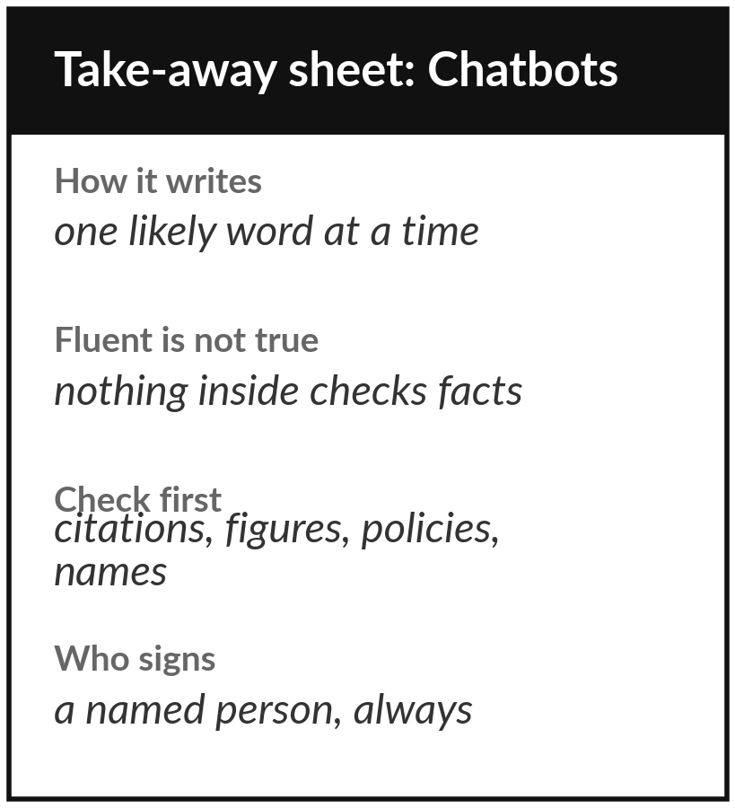
Keep the sheet, and the drafting
task you added to your portfolio
What you keep from today
A one-page sheet: how a chatbot writes, why answers vary, where it invents, the five questions to ask of any answer, today’s recorded runs, and your new portfolio entry.
Our question today
Why does a chatbot sound so sure, and when can I trust what it writes?
Next session
Session 6: The AI market: models, vendors, and buy, rent or build.
Notes:
Keep the take-away sheet. It has the picture of a chatbot writing one likely word at a time, the raffle that explains why answers vary, the four places it invents, and the five questions to ask of any answer. It also has today’s recorded runs: the support list, American cities for a company in Jinja, and two careful answers about a court case that does not exist.
Your portfolio now holds a drafting task and the person who signs. In Session 6 we ask who makes these models, where your data goes, and how to choose a supplier.
We began with this question: Why does a chatbot sound so sure, and when can I trust what it writes? Before you go, say in one sentence what you can now say about it.

